Slide 1
Microsoft Azure Administrator AZ 104
Training By: Purshottam A

Slide 2
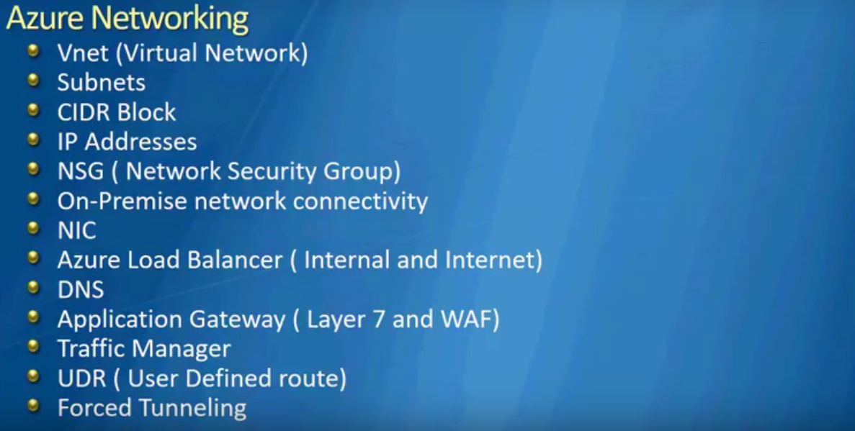
Azure Networking

Slide 3
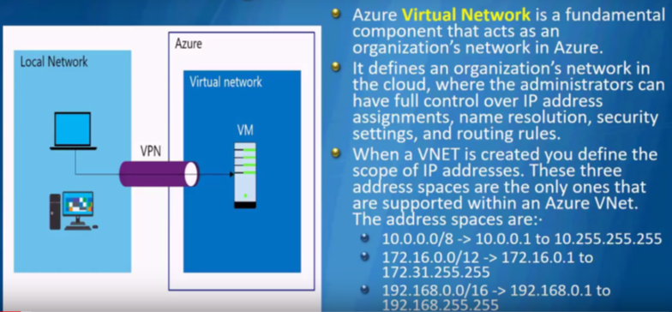
VNET, Subnet and CIDR Block

Slide 4
Subnet, CIDR, IP Addresses in Azure

Slide 5
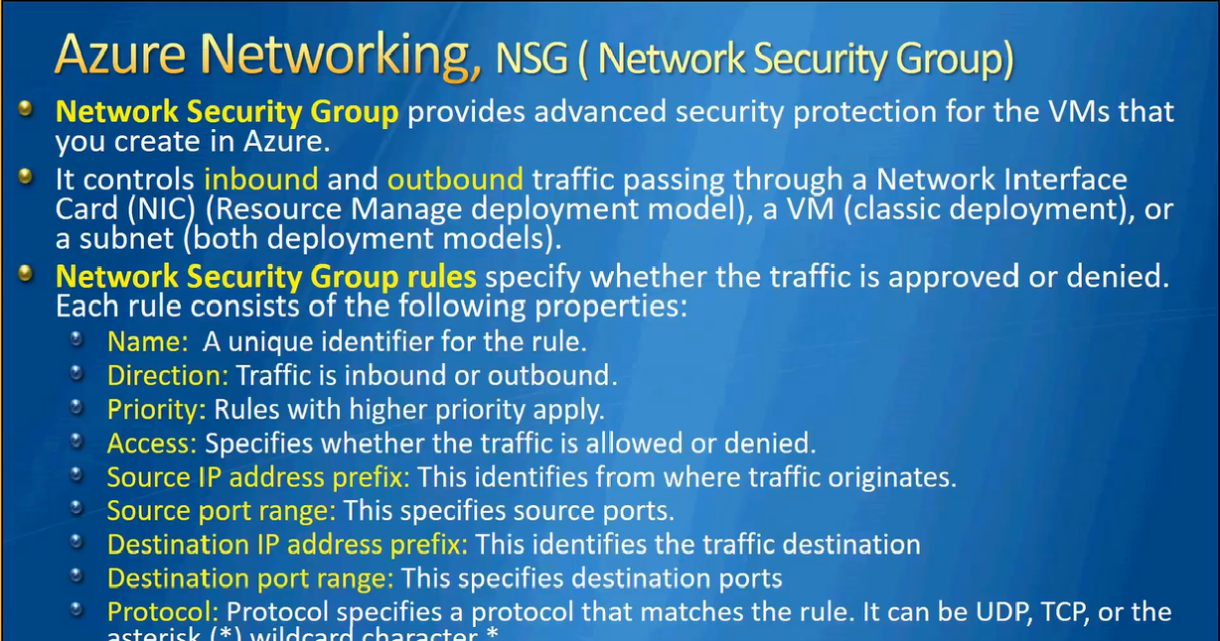
NSG

Slide 6
NSG

Slide 7
VNET and Subnet
Demo

Slide 8
NSG
One NSG can be applied to multiple subnets but cannot be vice-versa which means you cannot apply multiple NSGs to single subnet.
What you can do however is you can apply 1 NSG to subnet level and 1 NSG to NIC level.

Slide 9
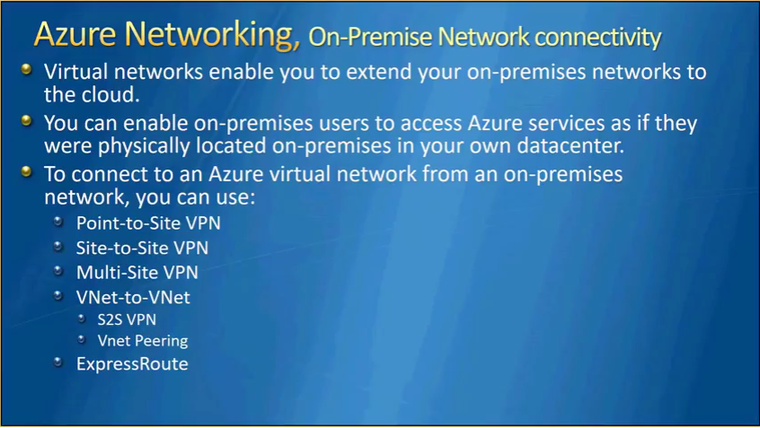
Azure Networking

Slide 10
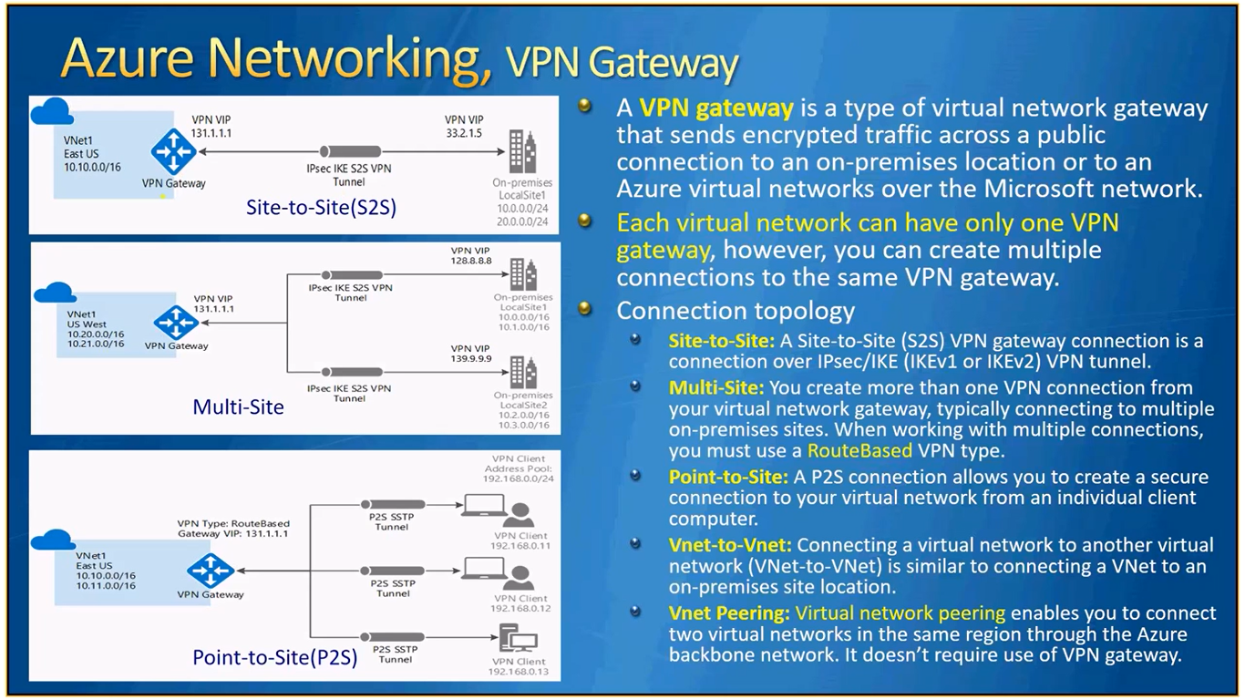
Azure Networking, VPN Gateway
Notes:
Route based works on routes and policy based works on policy. In case of multi-site, you use route based. Policy based = static routing.

Slide 11
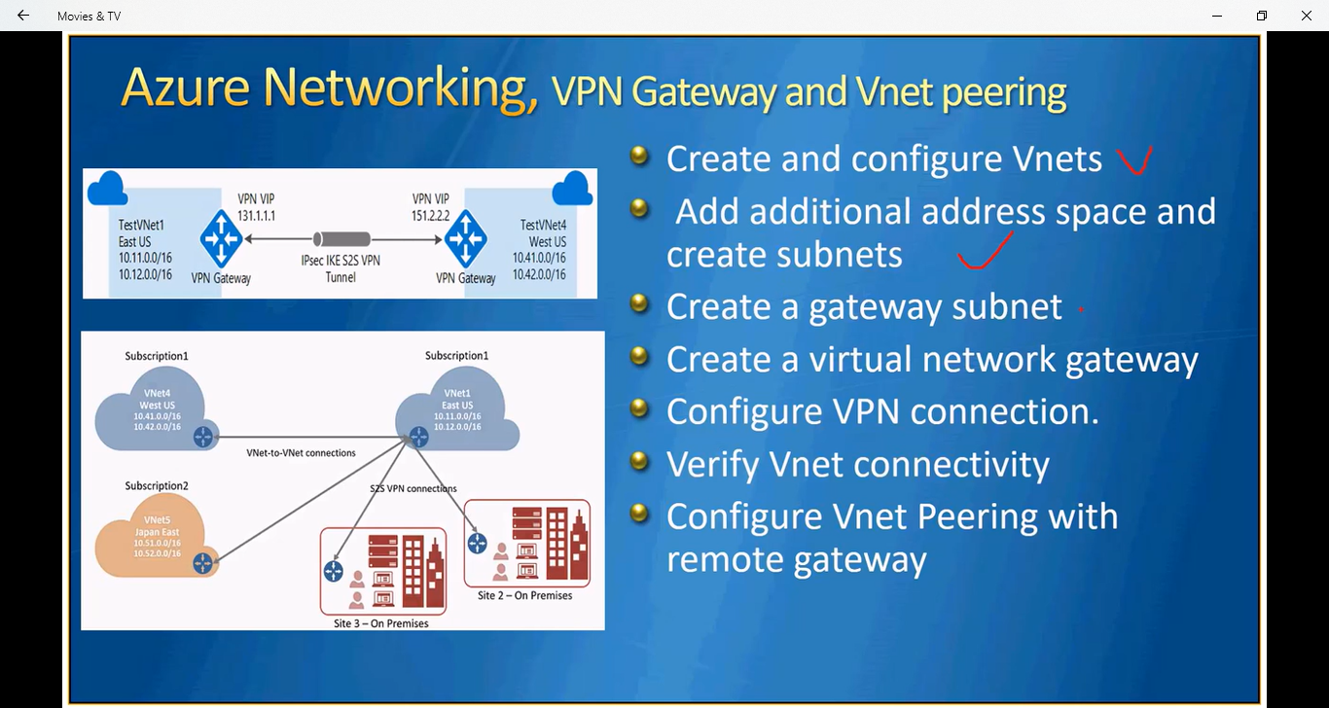
Demo

Slide 12
Demo
NSG Demo

Slide 13
demo
NSG Demo

